Slide 1

Data-Driven Insights for Strategic Decision-making
Research Proposal submitted in April 2025
Slide 1

Slide 2
Agenda
Research Aims and Objectives
Key Literature review
Research Methodology
Expected Outcomes
Planned timelines

Slide 3
Research Aims and Objectives
Analysis
Analyze capabilities of business analytics and AI in identifying unmet consumer needs.
Process
Research effectiveness of machine learning and predictive modeling.
Methodology
Explore methodologies for integrating data from diverse sources.
Investigation
Investigate challenges in using AI analytics (market segmentation & customer acquisition)
Framework
Develop a curriculum framework for business schools.

Slide 4
Research Methodology
Data Collection
Primary data: Semi-structured interviews with industry experts.
Secondary data: Review of academic literature, industry reports, market research.
Data Analysis
Quantitative analysis using statistical techniques and machine learning algorithms.
Qualitative analysis using thematic analysis.

Slide 5
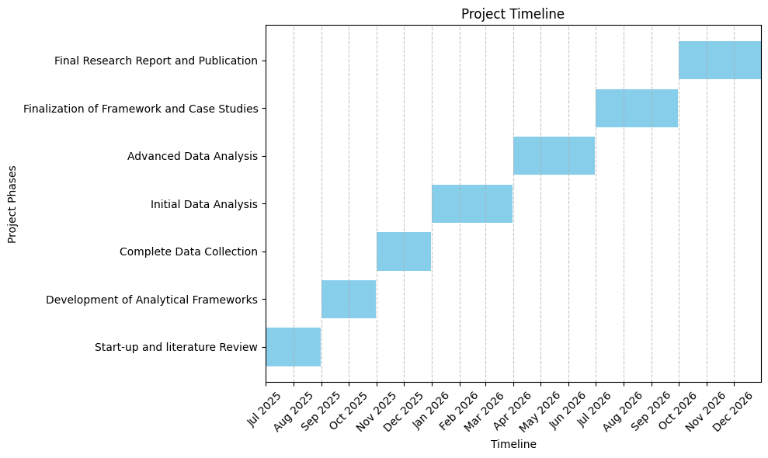
Timeline

Slide 6
Expected Outcomes and Impact
Concrete Outcomes
Academic publications.
Industry report with actionable insights.
Practical framework for business schools.
Case study compendium.
Conference presentations.
Impact
Advancement of business education.
Support for practical skills development.
Promotion of ethical and responsible innovation.

